Slide 1
ECDC COVID 19
File created on: 04-04-2020 17:00:11

Slide 2
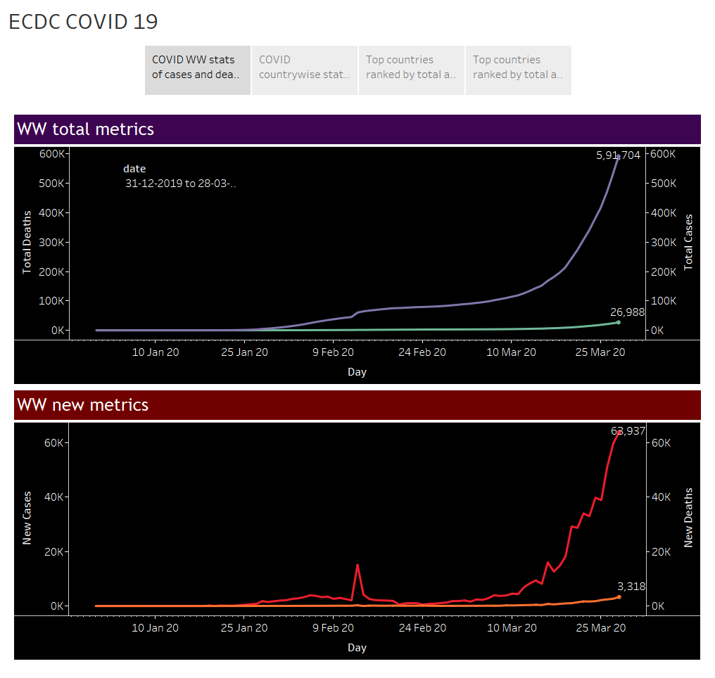

Slide 3
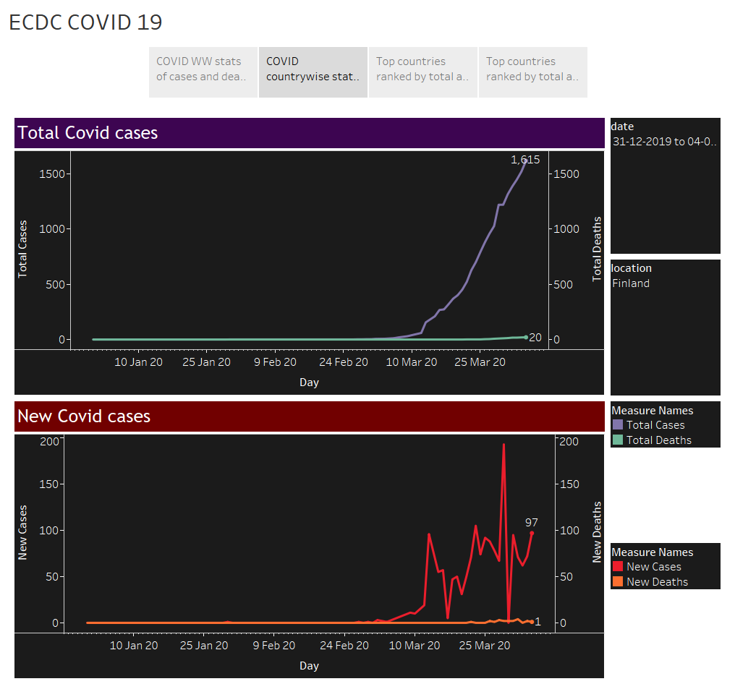

Slide 4
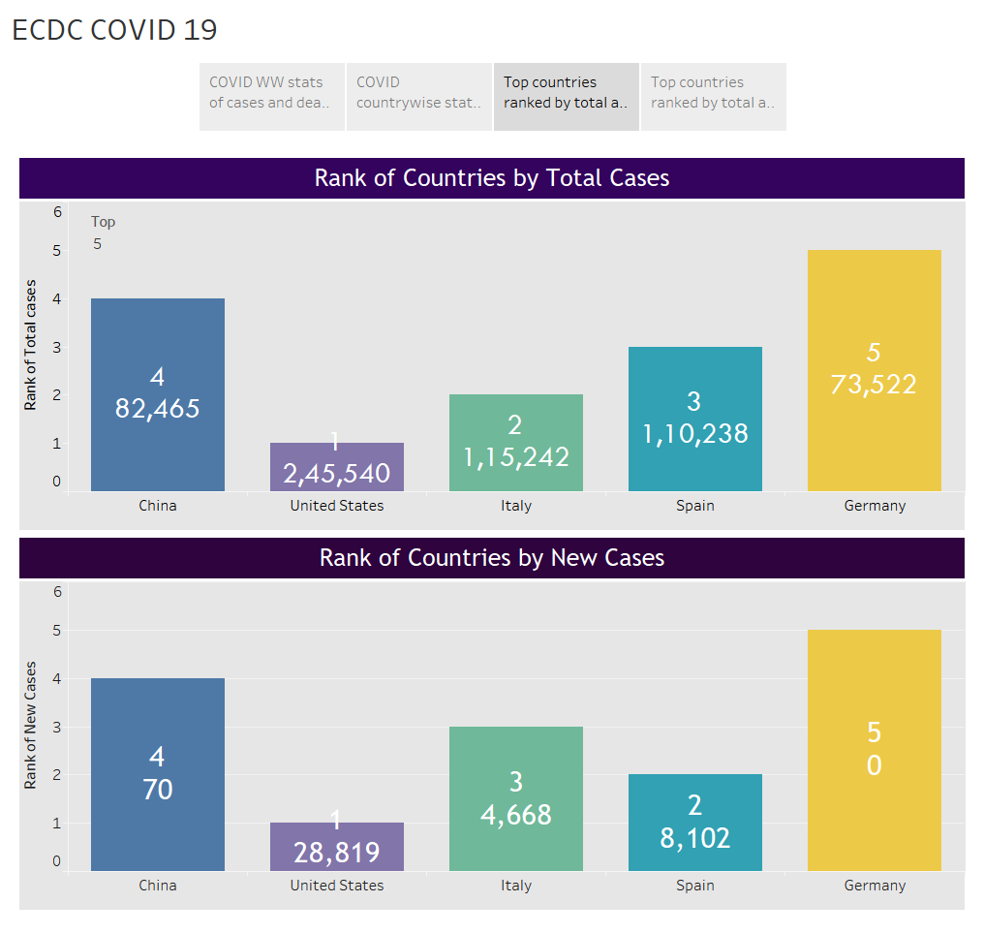

Slide 5
